Slide 1
Smart Contract Similarity Detection
Team One
Miao Miao, Junaid Hashmi, Jeongwon Seo

Slide 2
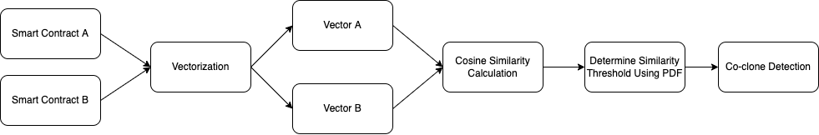
Main Goal of this Project
Given two smart contracts, automatically calculate their similarity (using cosine similarity)
Generate probability density function graphs to determine the threshold of the similarity score
Detect the co-cloned pairs and the non-co-cloned pairs of contracts along with their similarity values using the computed threshold in step 2
Figure 1. Flowchart Diagram of the Overall Project Goal
Notes:
Given a set of Smart Contract solidity file or binary code, identify a set of file or binary that are similar to the file from existing knowledge base

Slide 3
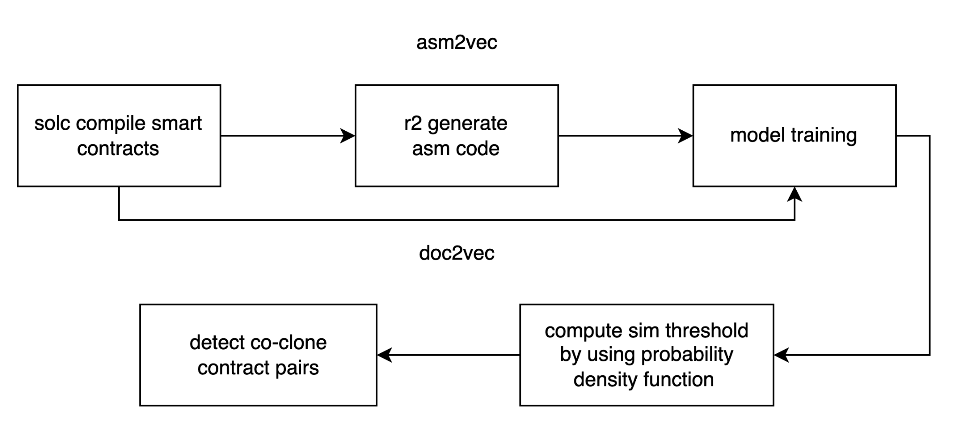
Project Flow
Figure 2. Flowchart Diagram of the Overall Project Workflow

Slide 4
Proposed Use Cases
Preprocess Data
Compile Source Code to Opcode & Binary Code
Convert Binary Code to Assembly Code
Train the model under DOC_2_VEC Model
Train the model under ASM_2_VEC Model
Generate the Probability Density Function Graphs
Distinguish the Co-Cloned Contracts and the Non-Co-Cloned Contracts

Slide 5
Distribution of the Use Cases

Slide 6
Iteration 1
ID: UC1 | Title: Preprocess Data |  |  | Priority: 1
Description: Filter out bad contracts based on the white list and black list. Split all smart contracts into 80% for training and 20% for testing.
Preconditions: Smart contracts, black and white lists are accessible
Postconditions: Py-sloc-x and radare2 libraries are correctly integrated
ID: UC2 | Title: Compile Source Code to Opcode & Binary Code |  |  | Priority: 1
Description: Given smart contract source code, using solc compiler to generate opcode and binary code to prepare data for Doc_2_Vec model training
Preconditions: Smart contracts are filtered and splitted into training and testing sets
Postconditions: Gensim and Asm_2_Vec libraries are correctly integrated

Slide 7
Iteration 1
ID: UC3 | Title: Convert Binary Code to Assembly Code |  |  | Priority: 1
Description: After solc generates binary code, using radare2 to analyze control flow graph and convert binary code to assembly code to prepare data for model training.
Preconditions: Binary code is correctly generated by solc and accessible by radare2.
Postconditions: Gensim and Asm_2_Vec libraries are correctly integrated

Slide 8
Iteration 2
ID: UC4 | Title: Train the model under DOC_2_VEC Mode |  |  | Priority: 1
Description: Using the functions provided by Gensim library to create, train, save a DOC_2_VEC model.
Preconditions: Training set is preprocessed and accessible
Postconditions: A DOC_2_VEC model is successfully trained and saved
ID: UC5 | Title: Train the model under ASM_2_VEC Mode |  |  | Priority: 1
Description: Using the functions provided by the ASM_2_VEC library to create, train, save an ASM_2_VEC model
Preconditions: Training set is preprocessed and accessible
Postconditions: An ASM_2_VEC model is successfully trained and saved

Slide 9
Iteration 3
ID: UC6 | Title: Generate the Probability Density Function Graphs |  |  | Priority: 1
Description: Compute the probability density from a certain dataset to determine the threshold similarity value
Preconditions: All similarity values are generated by the trained models and the data is accessible
Postconditions: The probability density function graphs are generated as a PNG image
ID: UC7 | Title: Distinguish the Co-Cloned Contracts and Non-Co-Cloned |  |  | Priority: 1
Description: Using the threshold value from UC5, find the co-cloned contract pairs and non-co-cloned contract pairs
Preconditions: A threshold value from the probability density graph is determined
Postconditions: All relevant data is written to a newly generated CSV file and correctly exported

Slide 10
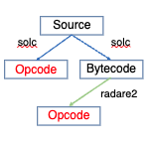
What is Solc?
What is Radare2?
> Solc, Solidity compiler, is a compiler that converts from a high-level solidity language into Ethereum Virtual Machine (EVM) bytecode so that it can be executed on the blockchain by EVM
> It is a contract-oriented, high-level language whose syntax is similar to that of JavaScript
> Radare2 (also known as r2) is an open-source reversing framework to help disassemble, debug, analyze, compare data, and manipulate binary files
> This framework helps convert the binary code to opcode and prepare the data for model training
Figure 3. Flow of converting source code to opcode and bytecode to opcode using Solc and/or Radare2

Slide 11
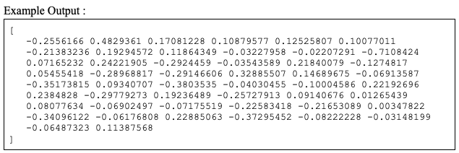
What is DOC_2_VEC?
> Doc2Vec is a model that represents each document as a vector using the Gensim library
> This creates a vector representation of a group of words taken collectively as a single unit
Step 1. Train the model by creating a tagged document
Step 2. Initialize the model using the command gensim.models.doc2vec.Doc2Vec();
Step 3. Build the vocabulary
Step 4. Train the Doc2Vec Model
Figure 4. Expected Output of the Vector Representation

Slide 12
What is ASM_2_VEC?
> ASM_2_VEC is an assembly clone search approach which learns a vector representation of an assembly function by discriminating it from the others
> It does not require any prior knowledge such as the correct mapping between assembly functions or the compiler optimization level used
Step 1. Train a representational model and produce a numeric vector for each repository function
Map a repository function to a vector (the vector representation of the function to be learned in the training model)
The operands and operations in the opcode instructions will be considered as tokens
Each token will then be mapped into two different numeric vectors
Step 2. After training, this will represent a token’s lexical semantics which will help visualize the relationship among the tokens
Notes:
> It learns lexical semantic relationships of tokens appearing in assembly code and represents a function as an internally weighted mixture of latent semantics

Slide 13
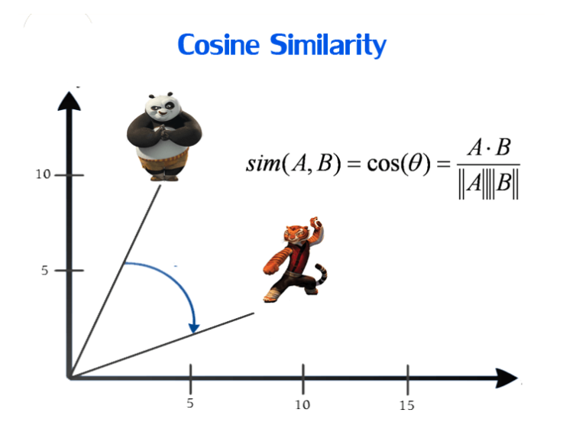
Cosine Similarity
> Cosine Similarity is a measurement that quantifies the similarity between two or more vectors
> Objective: have words with similar context occupy close spatial positions
> Mathematically, the cosine of the angle between such vectors should be close to 1 (or angle close to 0)
Figure 5. A Representation of Cosine Similarity on a XY Graph

Slide 14
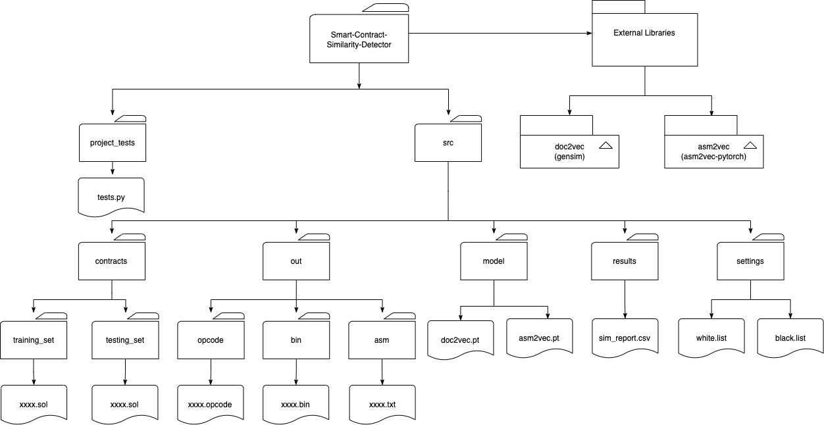
Project Structure
Figure 6. Diagram of Overall Project Structure

Slide 15
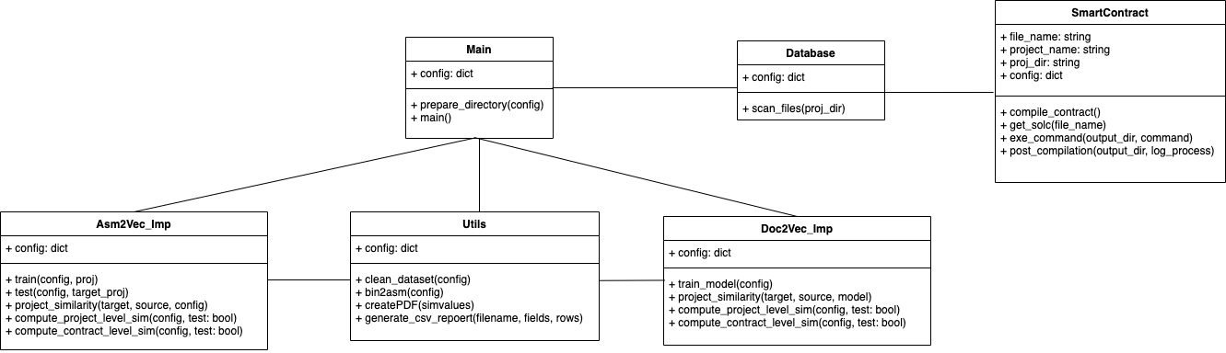
Class Diagram of the Internal Structure
Figure 7. Class Diagram of the Internal Structure

Slide 16
Main Limitation of ASM_2_VEC
This is a black box static approach which means it cannot explain or justify the returned results by showing the cloned subgraphs or proving symbolic equivalence
In other words, it has limited interpretability

Slide 17
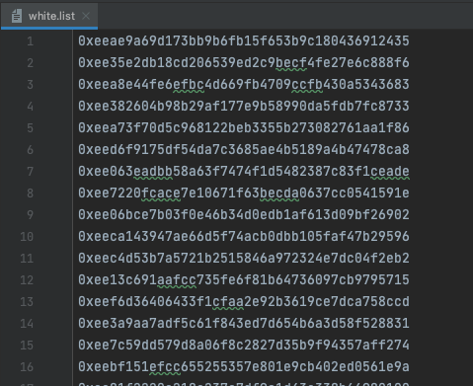
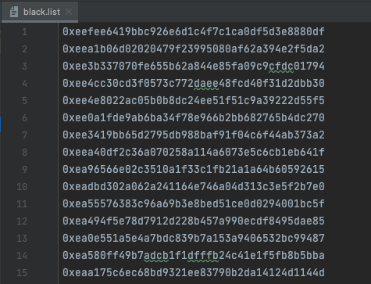
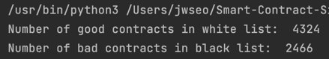
White vs. Black Lists
Figure 8. Screenshot of white.list and black.list & its Results

Slide 18
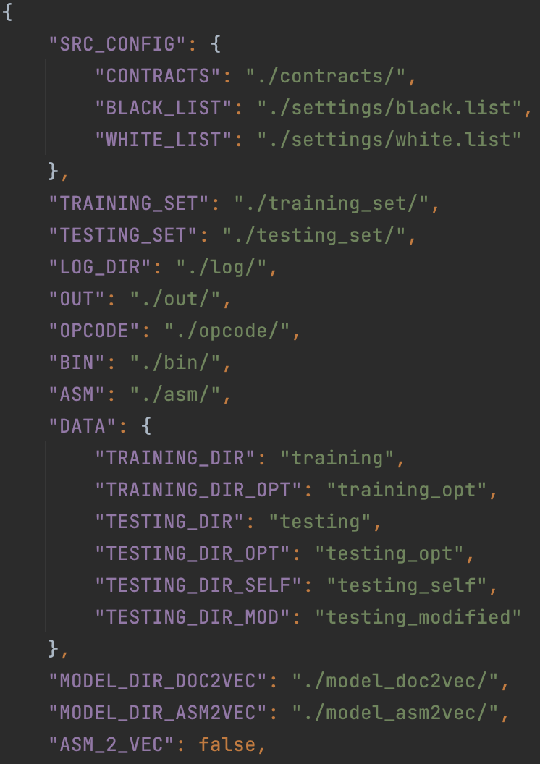
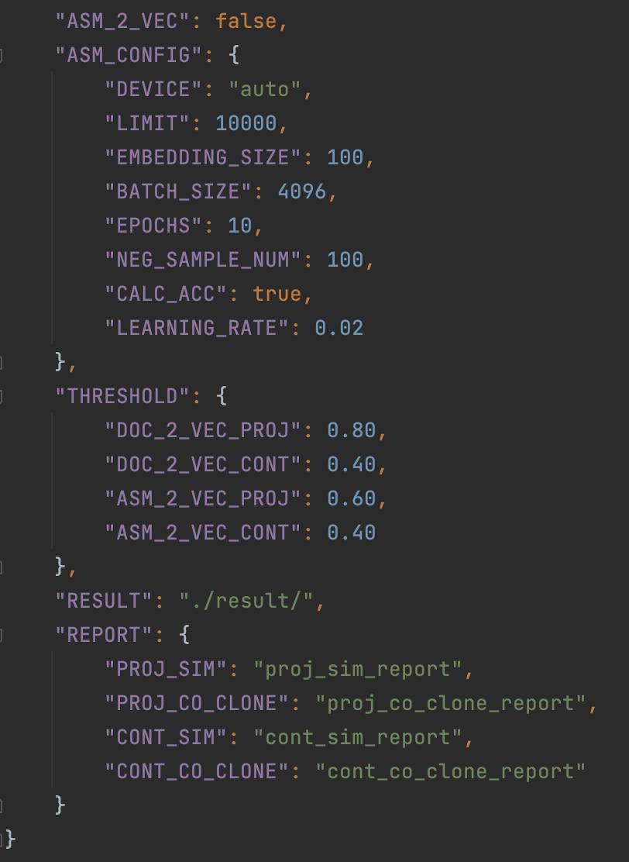
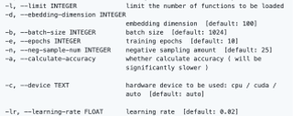
config.json
Users can change the configurations by updating the config.json file:​
​
> Users can change between the two models: DOC_2_VEC and ASM_2_VEC​
> Users can modify the different configs/settings for the ASM_2_VEC model (described below)​
Figure 9. config.json file and the list of settings

Slide 19
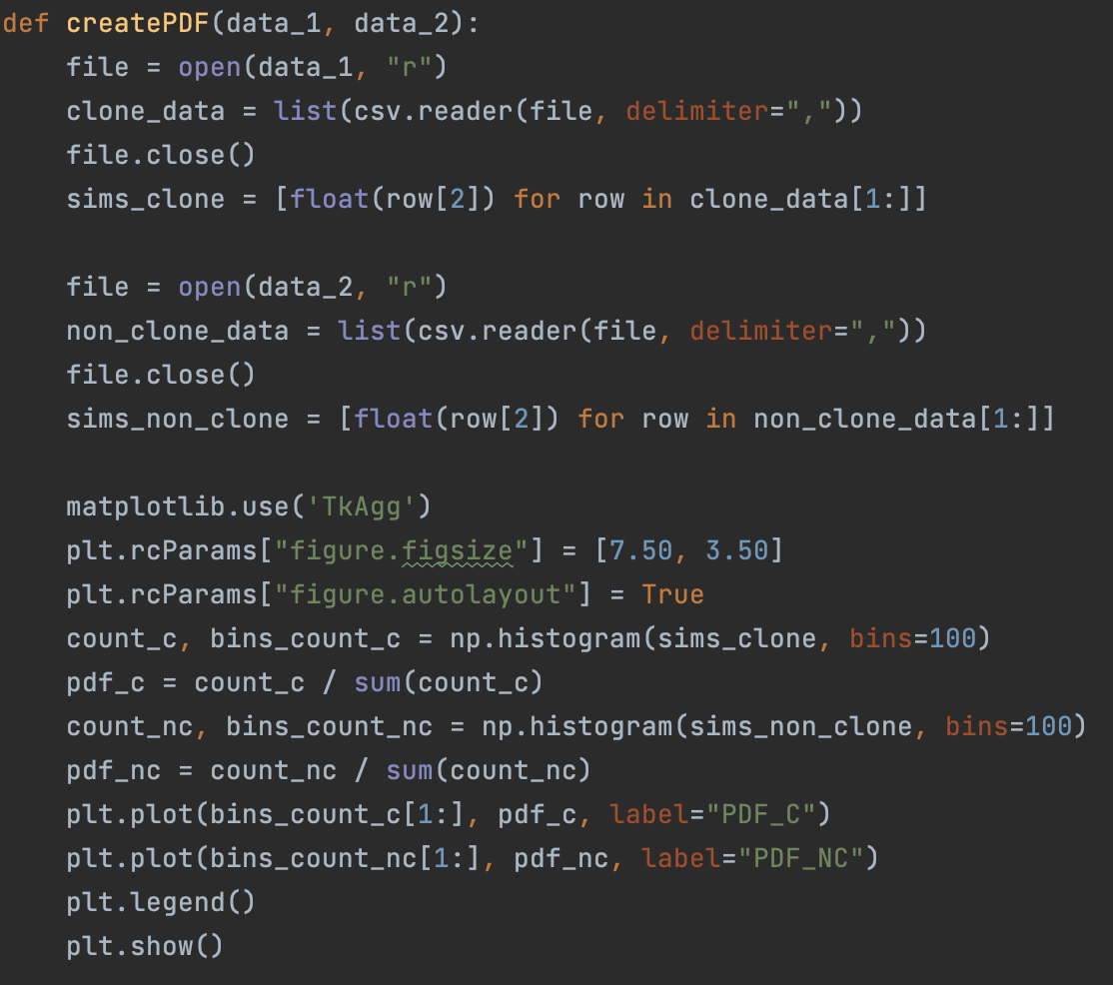
Probability Density Function (PDF)
> A function that describes a continuous, random probability distribution
> This function helps us to find the chances that the value of a variable will occur within a specified range of values
> Implementation:
matplotlib library is used to create the PDF graphs
> This graph helped us find the threshold to determine
whether two contracts are co-cloned pairs or not
Figure 10. Screenshot of code to create PDF Graphs
Notes:
Why do we need it ? Using similarity score (threshold) to distinguish co-clone and not co-cloned smart contracts

Slide 20
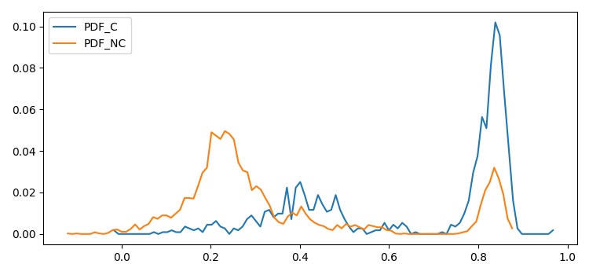
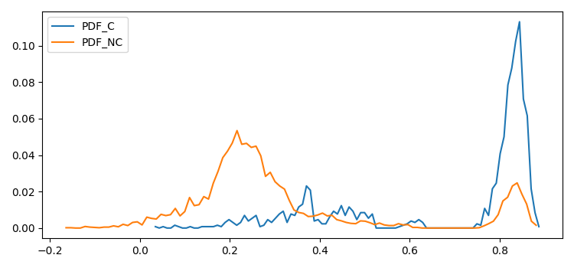
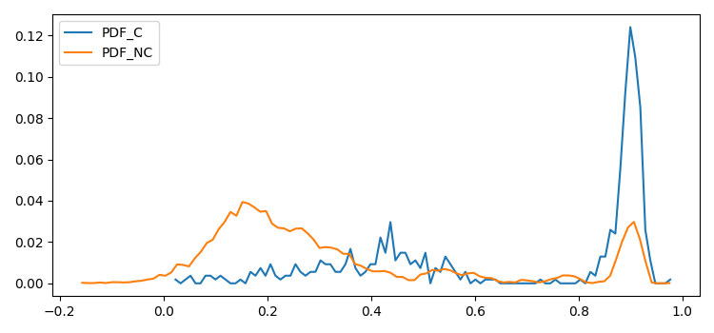
Probability
Density
Function
Graphs
Figure 11. 1100C_3600NC
Figure 12. 1300C_6000NC
Figure 13. 550C_7000NC
Notes:
Threshold = 0.4

Slide 21
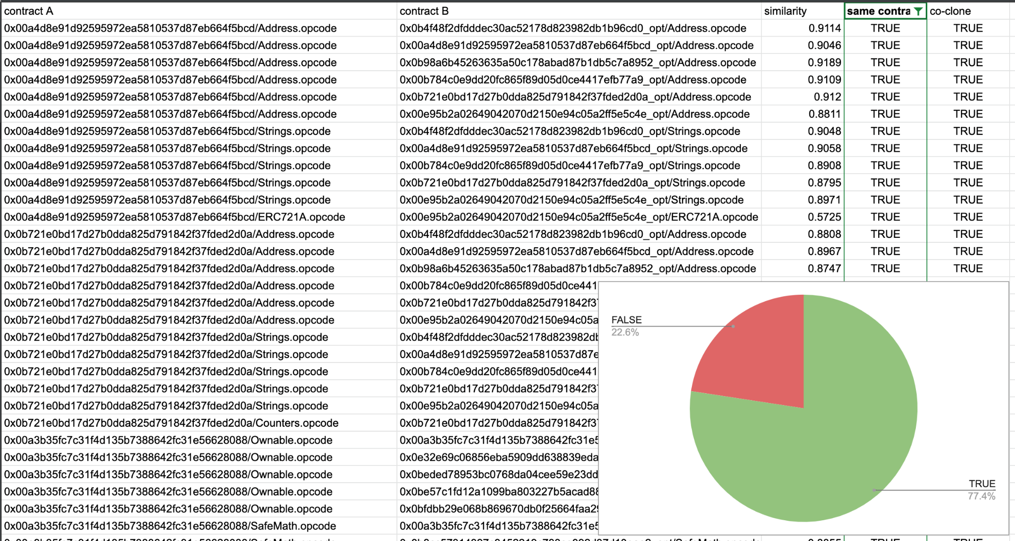
Figure 14. 2304 Contract-Level Co-Clone Report & Pie Chart (Threshold = 0.40)
Notes:
project name as the ground truth although it is not perfect

Slide 22
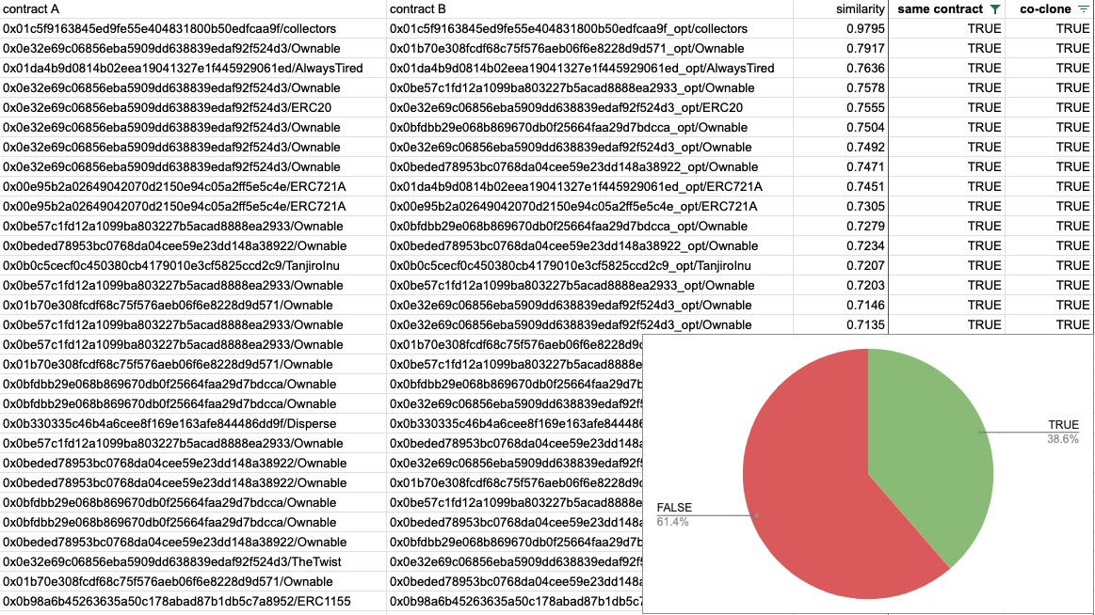
Figure #. 2117 ASM_2_VEC Contract-Level Co-Clone Report & Pie Chart
Notes:
remove asm_2_vec?

Slide 23
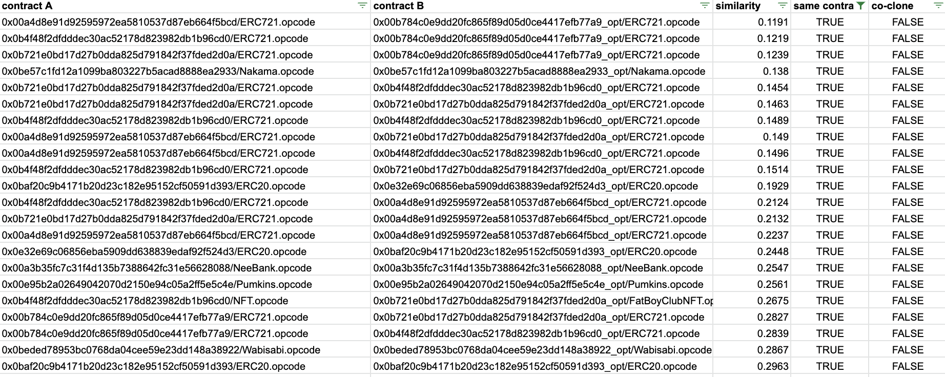
Part 1 - Data Analysis (Negative)
Figure 15. Results of Negative Co-Cloned Pairs with Same Contract Names
Notes:
False-Positive Data Explanations - Contract Pairs that have the same name with low similarity
they use different optimization parameter → limitation of our approach

Slide 24
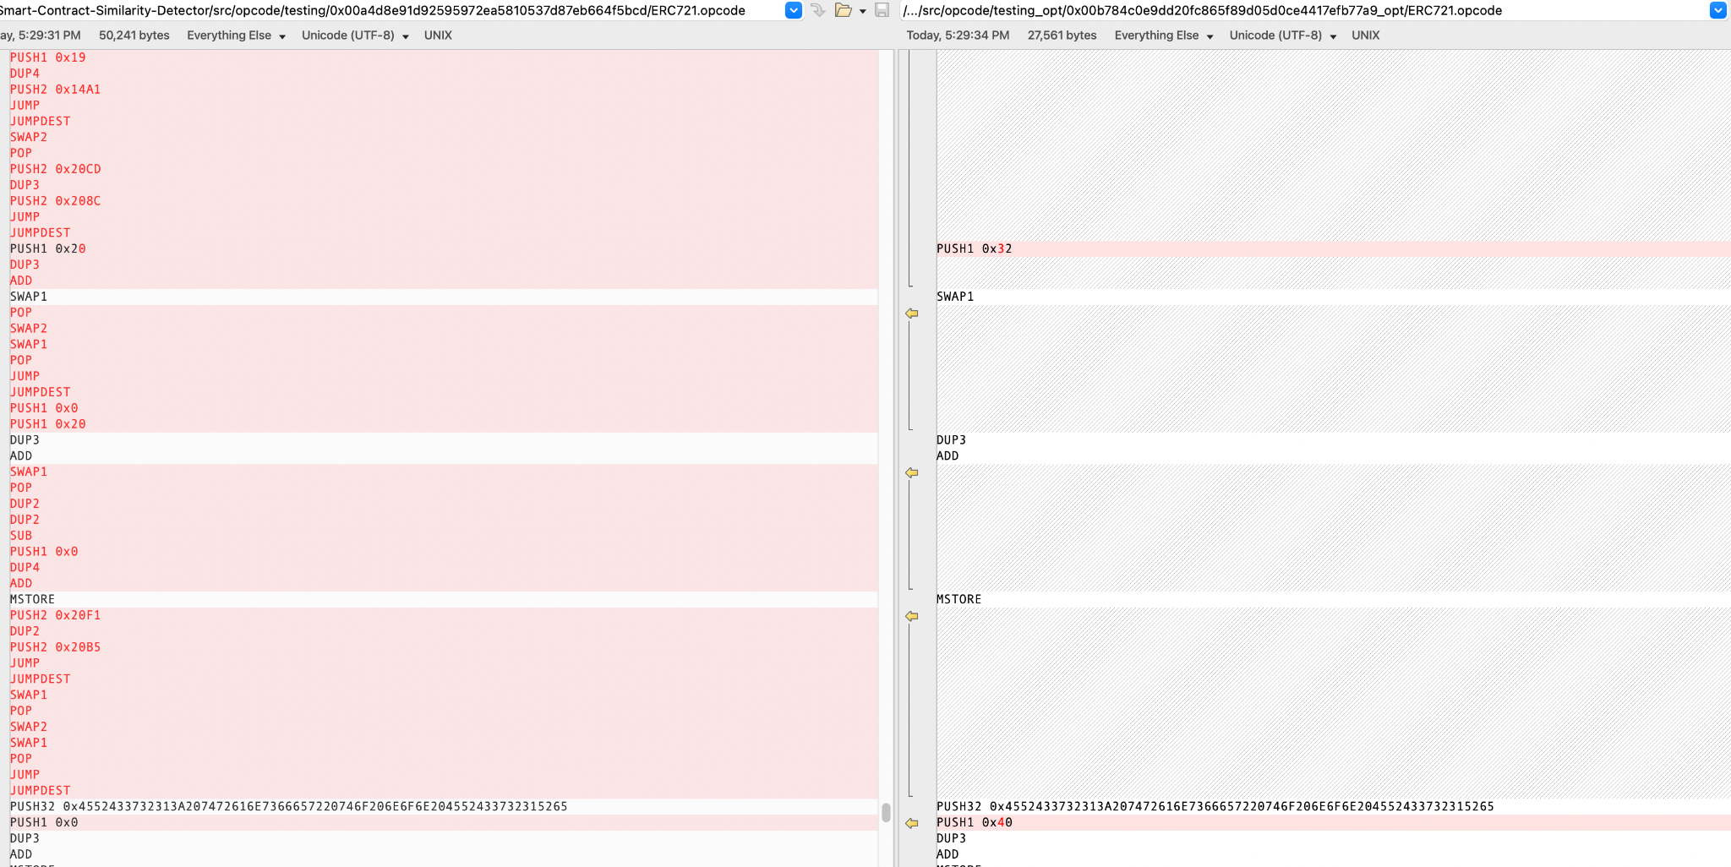
Example 1. Opcode Comparison
Figure 16. Opcode Comparison Between the Contract Pair from Figure 14 - Yellow
Notes:
change to source code

Slide 25
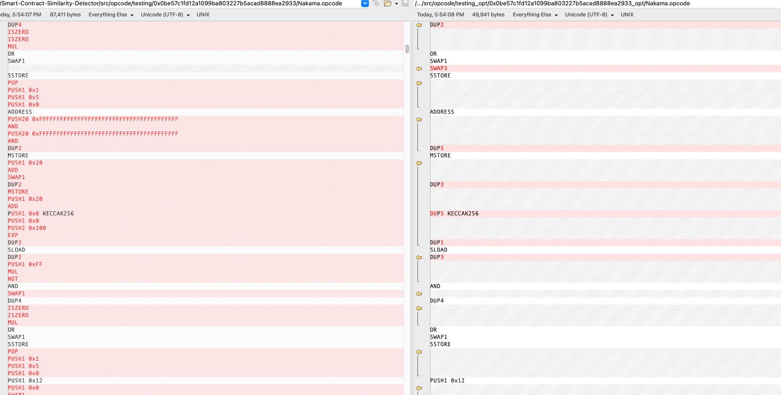
Example 2. Opcode Comparison
Figure 17. Opcode Comparison Between the Contract Pair from Figure 14 - Blue
Notes:
change to source code

Slide 26
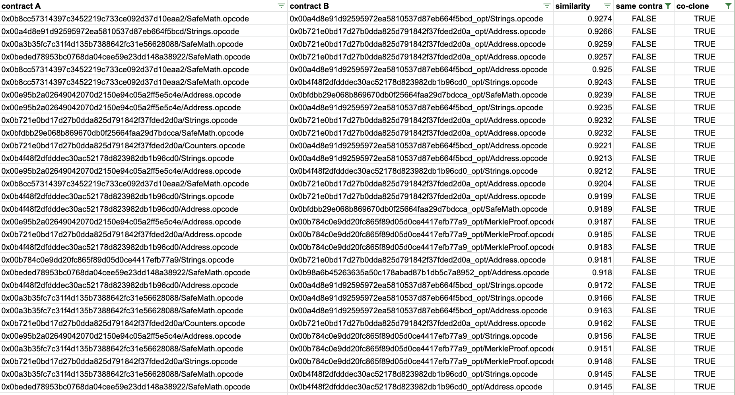
Part 2 - Data Analysis (Positive)
Figure 18. Results of Positive Co-Cloned Pairs with Different Contract Names

Slide 27
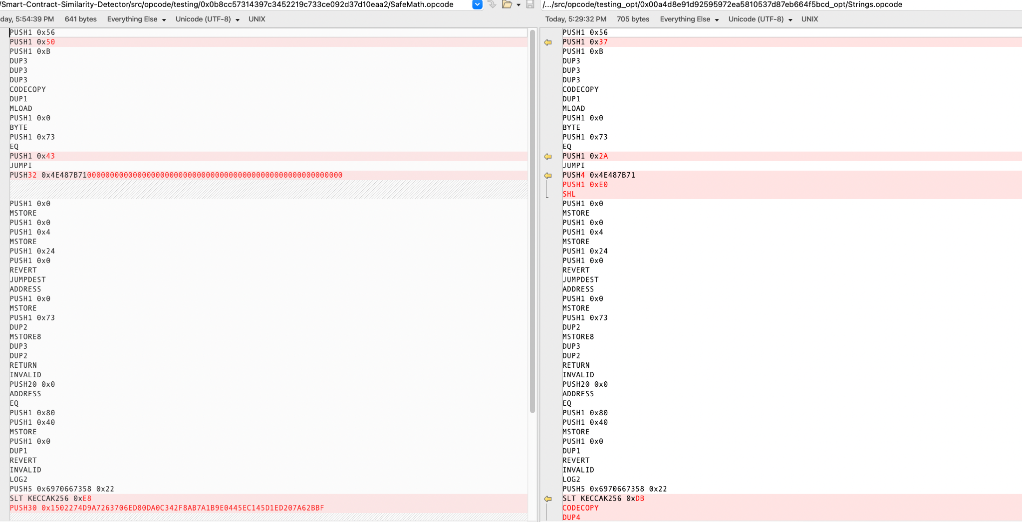
Example 1. Opcode Comparison
Figure 19. Opcode Comparison Between the Contract Pair from Figure 17 - Yellow

Slide 28
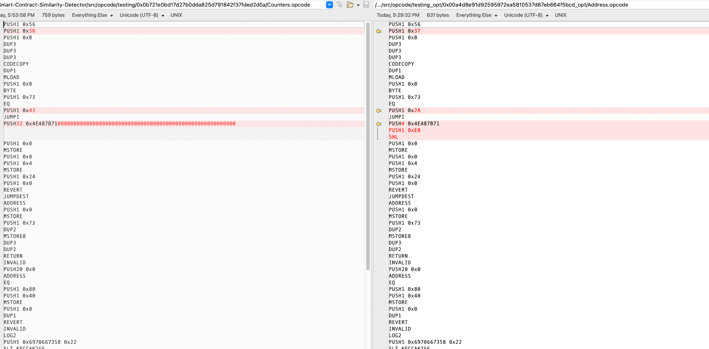
Example 2. Opcode Comparison
Figure 20. Opcode Comparison Between the Contract Pair from Figure 17 - Blue

Slide 29
Demo

Slide 30
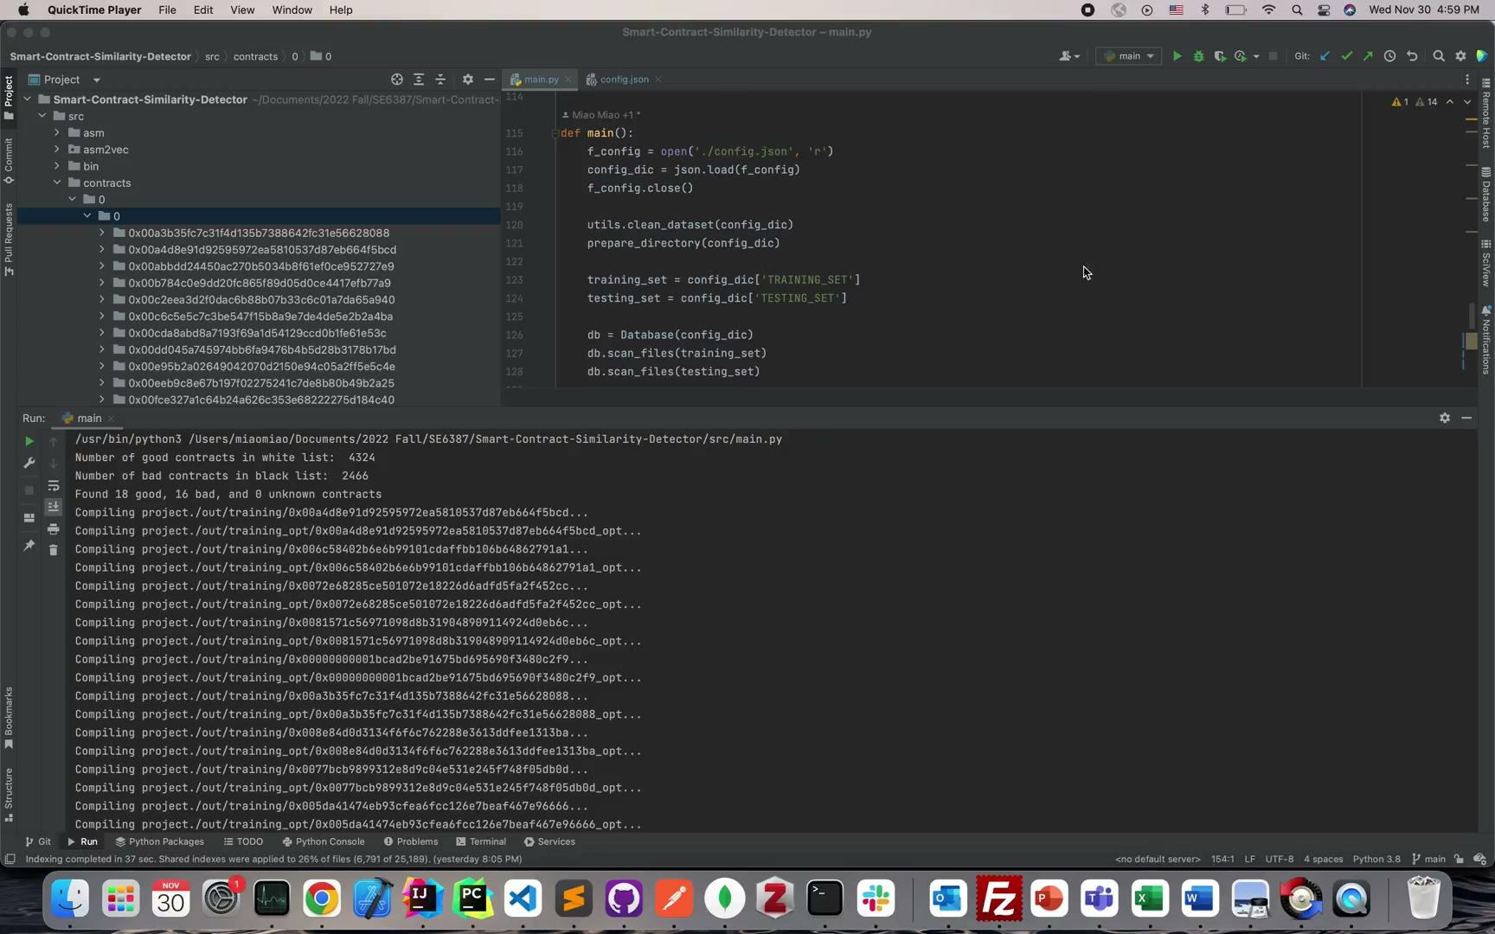
Filter Out Bad Projects & Compile Good Projects

Slide 31
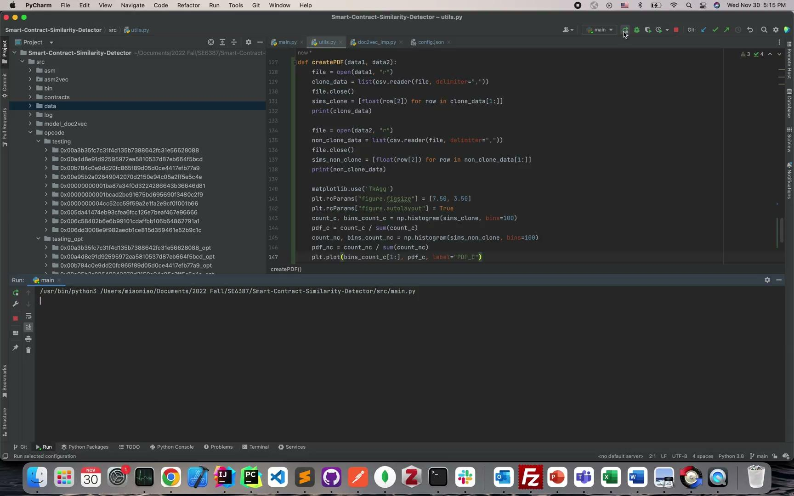
Create Probability Density Graphs

Slide 32
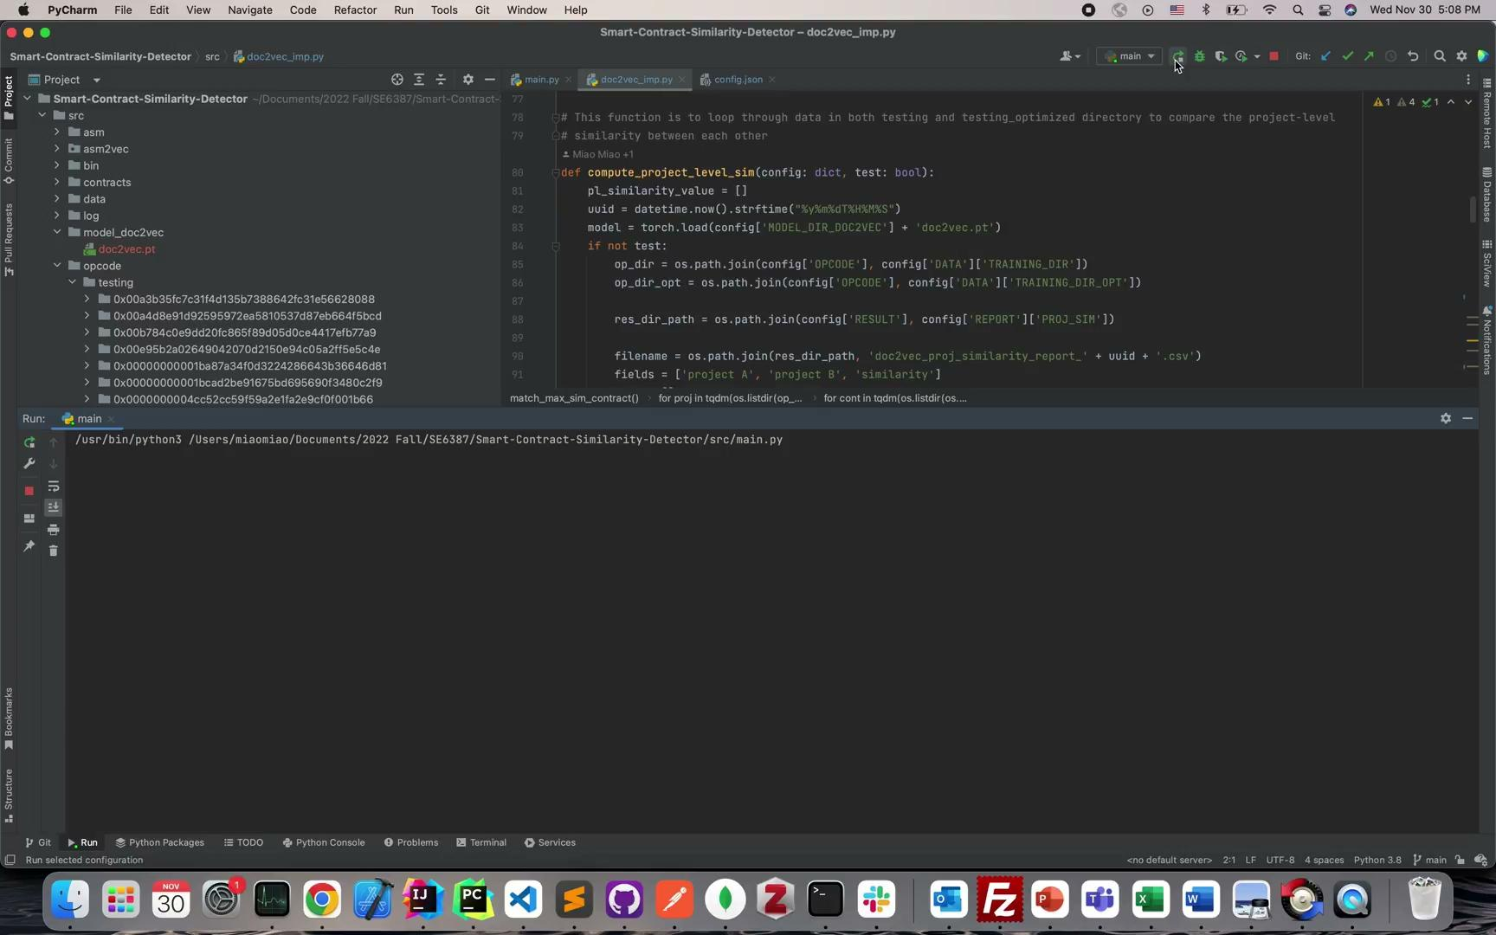
Compute Similarity Values & Generate CSV Reports

Slide 33
Walkthrough of the Final Code

Slide 34
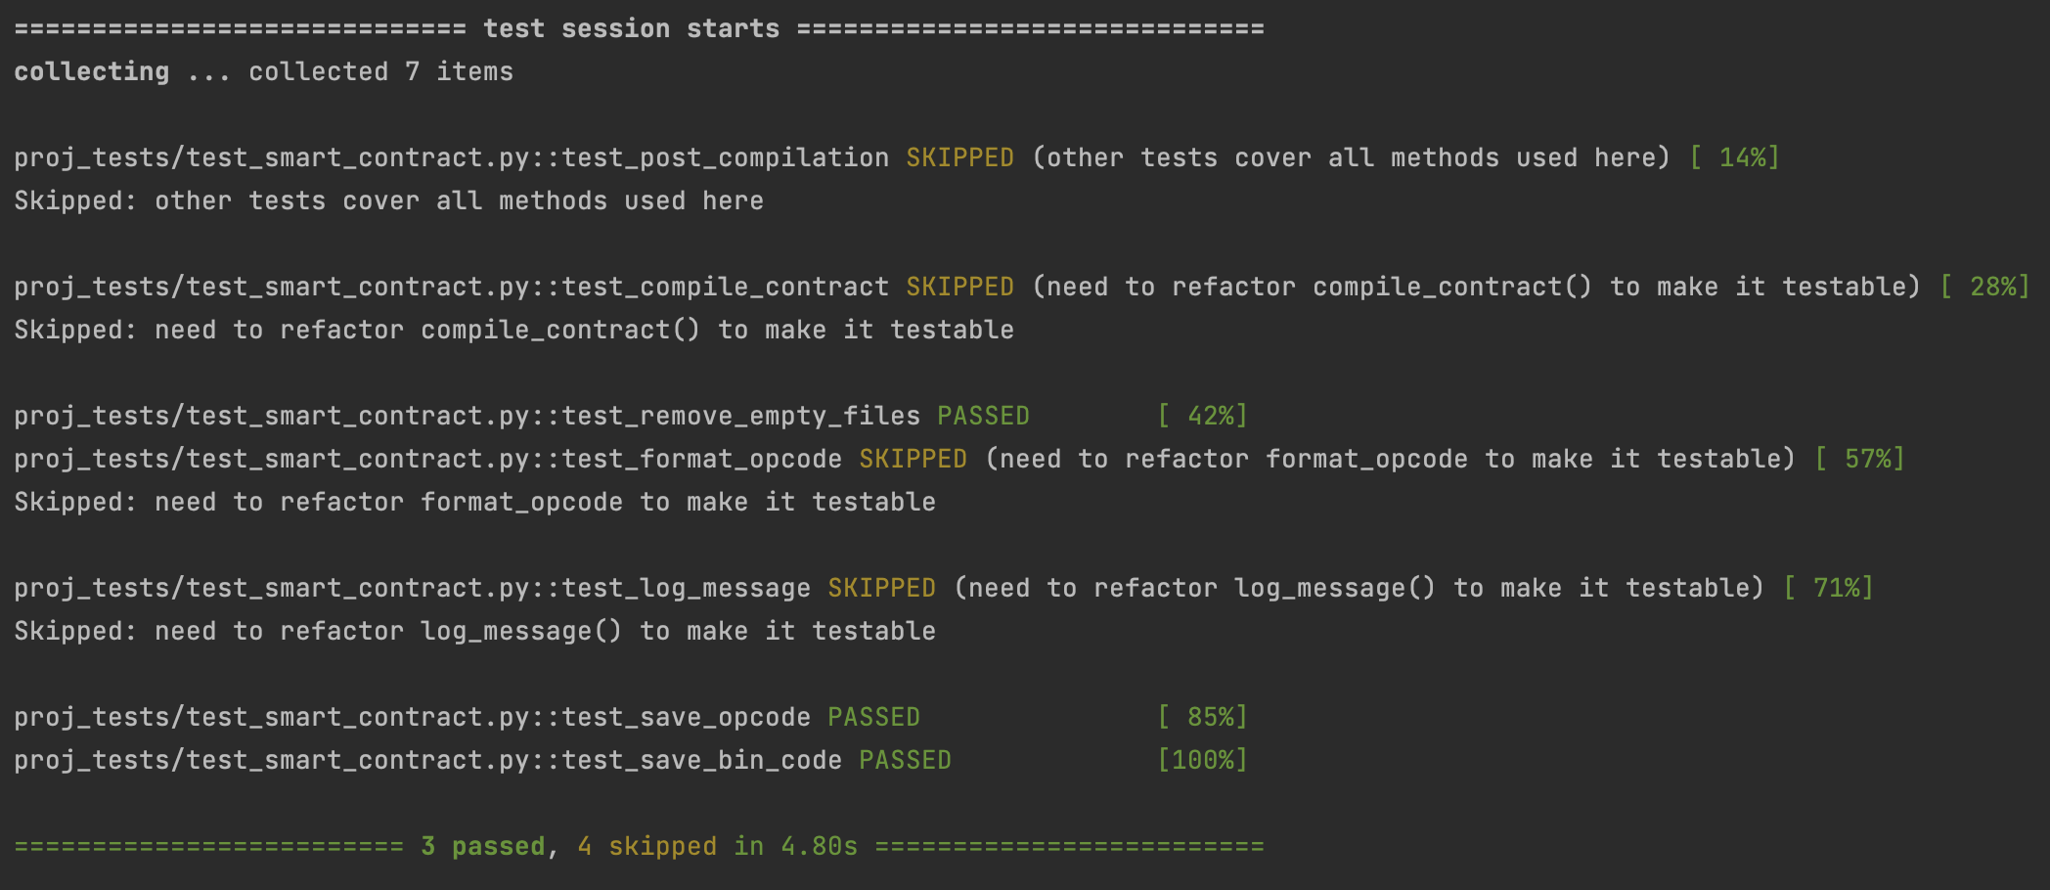
Figures 21. Unit Testing - Console Log Messages

Slide 35
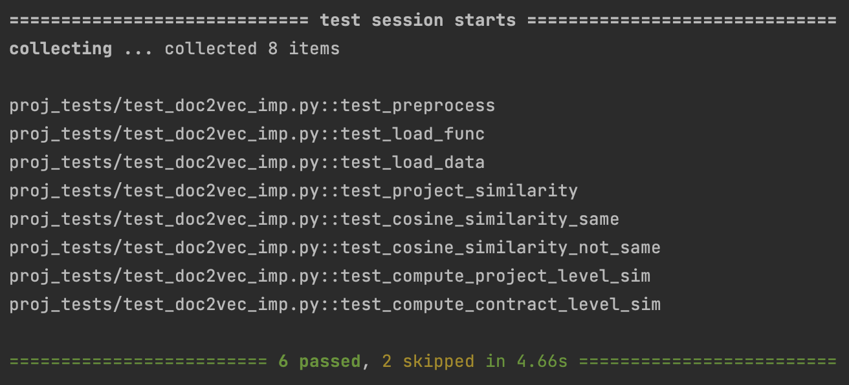
Figures 22. Unit Testing - Console Log Messages

Slide 36
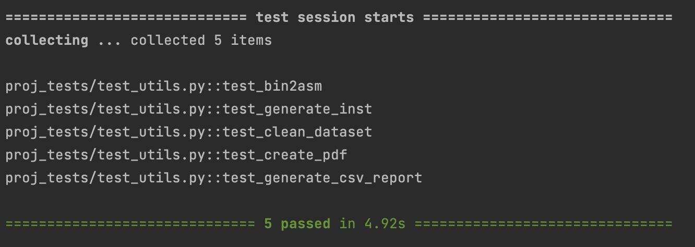
Figures 23. Unit Testing - Console Log Messages

Slide 37
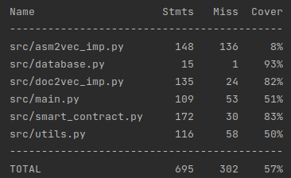
Figure 24. Overall Test Coverage Report

Slide 38
Wiki Page

Slide 39
Q & A

Slide 40
List of Figures
Figure 1. Flowchart Diagram of the Overall Project Goal
Figure 2. Flowchart Diagram of the Overall Project Workflow
Figure 3. Flow of converting source code to opcode and bytecode to opcode using Solc and/or Radare2
Figure 4. Expected Output of the Vector Representation
Figure 5. A Representation of Cosine Similarity on a XY Graph
Figure 6. Diagram of Overall Project Structure
Figure 7. Class Diagram of the Internal Structure
Figure 8. Screenshot of white.list and black.list & its Results
Figure 9. config.json file and the list of settings
Figure 10. Screenshot of code to create PDF Graphs
Figure 11. 1100C_3600NC
Figure 12. 1300C_6000NC
Figure 13. 550C_7000NC
Figure 14. 2304 Contract-Level Co-Clone Report & Pie Chart (Threshold = 0.40)
Figure 15. Results of Negative Co-Cloned Pairs with Same Contract Names
Figure 16. Opcode Comparison Between the Contract Pair from Figure 14 - Yellow
Figure 17. Opcode Comparison Between the Contract Pair from Figure 14 - Blue
Figure 18. Results of Positive Co-Cloned Pairs with Different Contract Names
Figure 19. Opcode Comparison Between the Contract Pair from Figure 17 - Yellow
Figure 20. Opcode Comparison Between the Contract Pair from Figure 17 - Blue
Figures 21 - 23. Unit Testing - Console Log Messages
Figure 24. Unit Testing - Overall Test Coverage Report

Slide 41
Works Cited
Baldawa, Sandeep. “RADARE2 For Reverse Engineering-PART1.” Medium, ITNEXT, 23 Sept. 2020, https://itnext.io/radare2-for-reverse-engineering-part1-eedf0a47b5cc.
“Gensim - doc2vec Model.” Tutorials Point, https://www.tutorialspoint.com/gensim/gensim_doc2vec_model.htm.
Karani, Dhruvil. “Introduction to Word Embedding and word2vec.” Medium, Towards Data Science, 2 Sept. 2020, https://towardsdatascience.com/introduction-to-word-embedding-and-word2vec-652d0c2060fa.
S. H. H. Ding, B. C. M. Fung and P. Charland, "Asm2Vec: Boosting Static Representation Robustness for Binary Clone Search against Code Obfuscation and Compiler Optimization," 2019 IEEE Symposium on Security and Privacy (SP), 2019, pp. 472-489, doi: 10.1109/SP.2019.00003.
“Solidity.” Solidity, https://docs.soliditylang.org/en/v0.8.17/.

